Slide 1

Human 2.0
presented by Armin Schneider

Slide 2
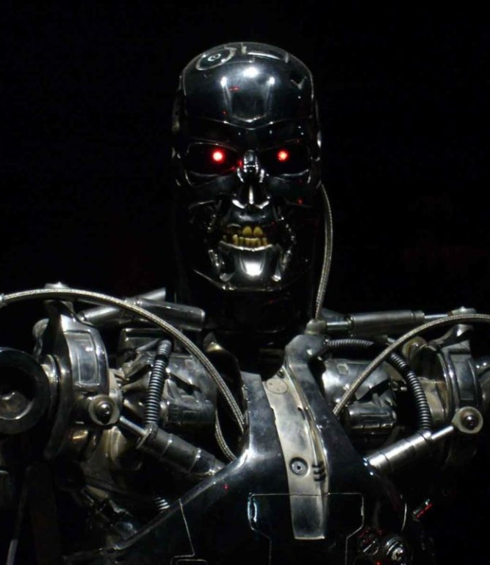
Overview
Who is Ray Kurzweil?
Are we merging with technology?
Possible downsides?

Slide 3
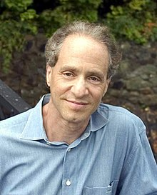
Ray Kurzweil
Born in: February 12, 1948 (age 74)
Inventions:
optical character recognition
speech recognition
Books:
“The Singularity is Near: When Humans Transcend Biology”
“The Age of Spiritual Machines”
2005

Slide 4
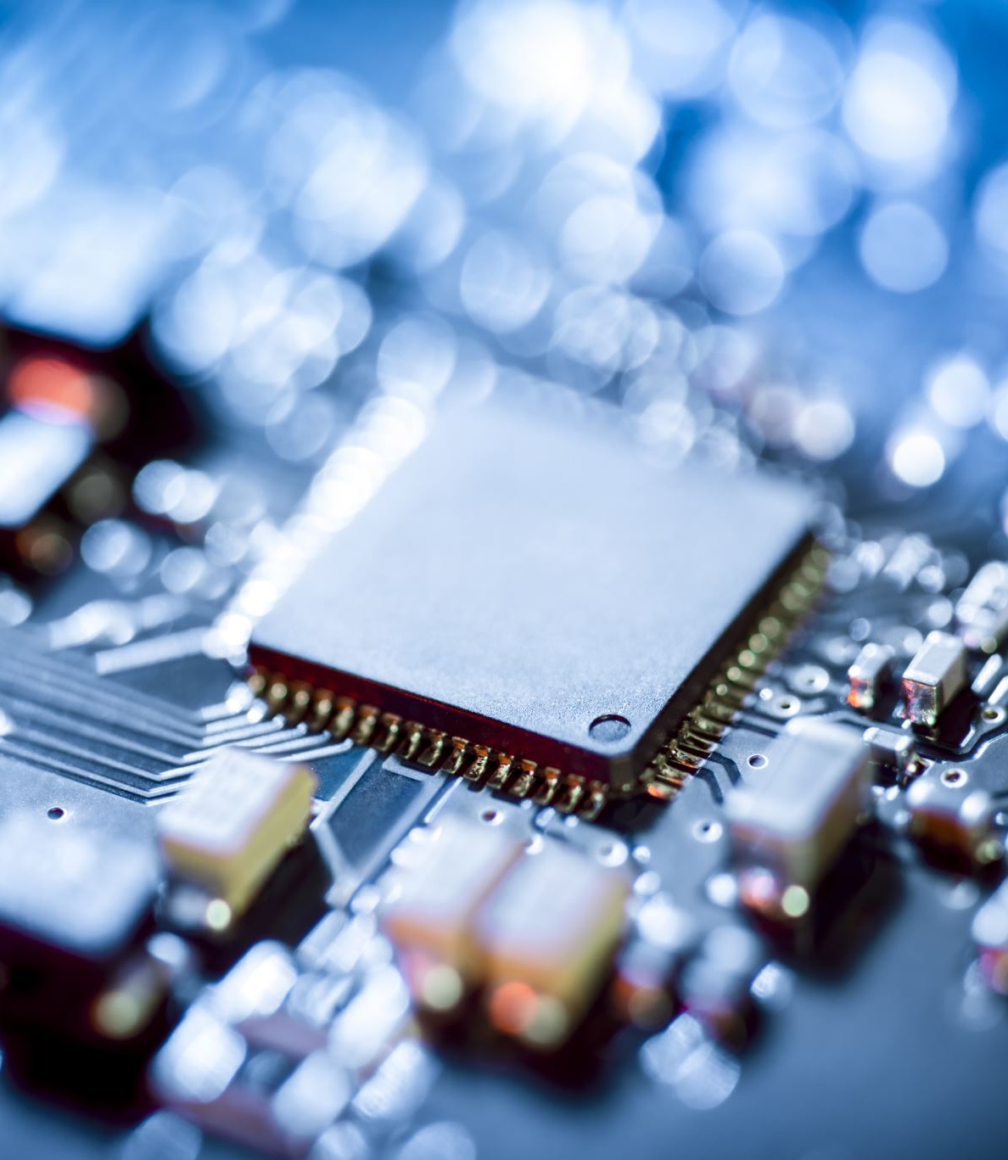
Are we merging with technology?
Controlling machines with your mind
Paying with an “in-built” chip
Being stronger, faster and “repairable”

Slide 5

Possible Downsides
A gab in society

